Slide 1

Hypothesis Testing
Marco Antonio Florenzano Mollinetti¹
¹University of Tsukuba, Systems Optimization Laboratory
mollinetti@syou.cs.tsukuba.ac.jp

Slide 2
Before we Begin
Go to the github repo:
https://github.com/Mollinetti/Statistics-R
Download the script for this class! (in the ‘scripts’ folder class_3!)
Run the first lines to load/install the required libraries

Slide 3
Agenda
Hypothesis Testing
Test of Hypothesis for one sample
Test of Hypothesis for Two samples

Slide 4
Hypothesis Testing
Test of Hypothesis for one sample
Test of Hypothesis for Two samples

Slide 5
Hypothesis Testing
Point estimators and statistical intervals belong to the field of descriptive statistics
Many problems require to decide whether we accept or reject a statement about some parameter
Hypothesis testing provide tools for making inferences within a degree of certainty

Slide 6
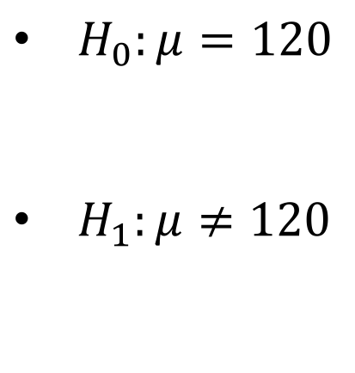
Hypothesis Testing
Since we use probability distributions to describe a population, hypothesis are made based on their parameters
Recall the blood pressure case from class 2:
$H_{0}:μ=120$
$H_{1}:μ≠120$
Null Hypothesis (mean of the sample is 120)
Alternative Hypothesis (mean of the sample is greater or less than 120)
Two-sided Hypothesis

Slide 7
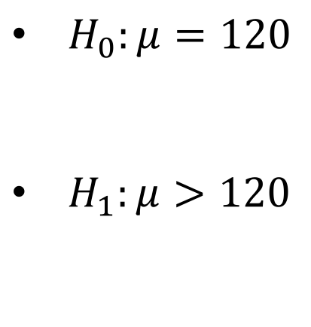
Hypothesis Testing
Since we use probability distributions to describe a population, hypothesis are made based on their parameters
Recall the blood pressure case from class 2:
$H_{0}:μ=120$
$H_{1}:μ>120$
Null Hypothesis (mean of the sample is 120)
Alternative Hypothesis (mean of the sample is greater/less than 120)
One-sided Hypothesis

Slide 8
Hypothesis Testing
“Testing the hypothesis involves taking a random sample, computing a test statistic from the sample data, and then using the test statistic to make a decision about the null hypothesis.” [Montgomery, p. 279]
If the alternative hypothesis is true, we say that we rejected the Null Hypothesis

Slide 9
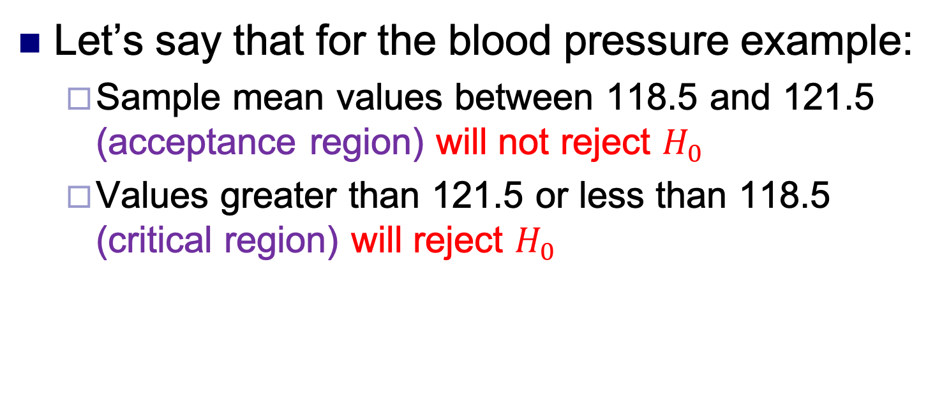
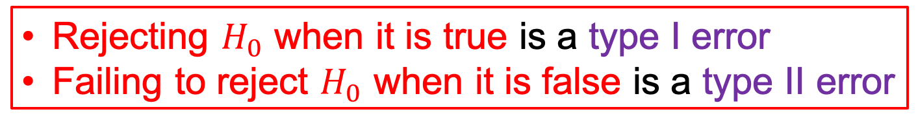
Hypothesis Testing
Let’s say that for the blood pressure example:
Sample mean values between 118.5 and 121.5 (acceptance region) will not reject $H_{0}$
Values greater than 121.5 or less than 118.5 (critical region) will reject $H_{0}$
Rejecting $H_{0}$ when it is true is a type I error
Failing to reject $H_{0}$ when it is false is a type II error

Slide 10
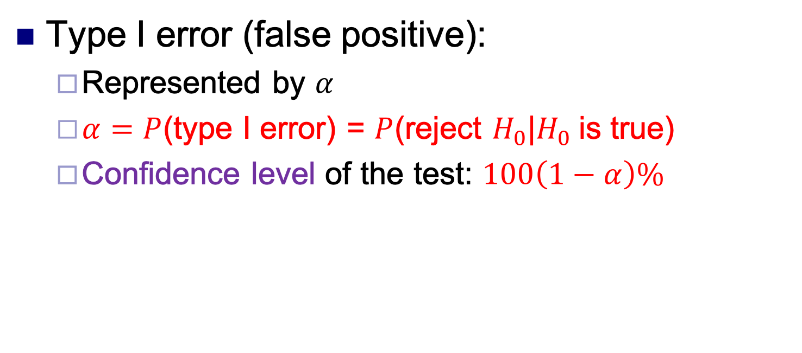
Hypothesis Testing
Type I error (false positive):
Represented by $α$
$α=P$(type I error) = $P$(reject $H_{0}$|$H_{0}$is true)
Confidence level of the test: $100\left(1−α\right)\%$

Slide 11
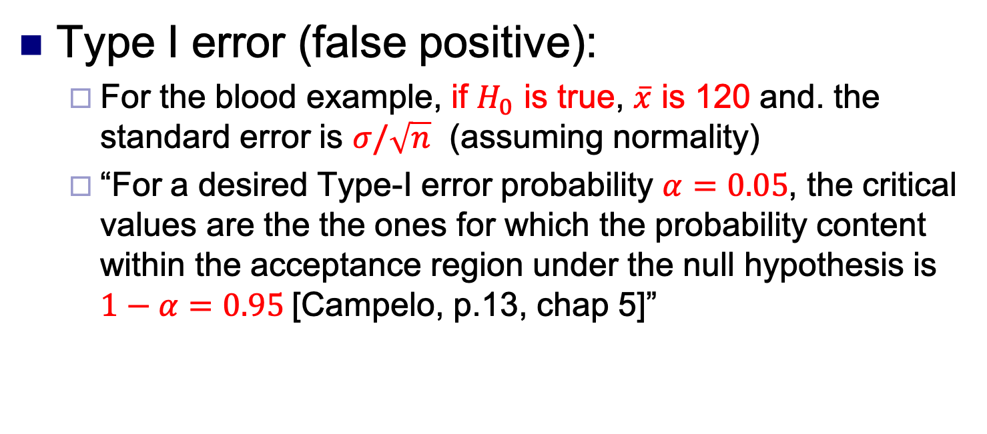
Hypothesis Testing
Type I error (false positive):
For the blood example, if $H_{0}$ is true, $\overline{x}$ is 120 and. the standard error is $σ/\sqrt{n}$ (assuming normality)
“For a desired Type-I error probability $α=0.05$, the critical values are the the ones for which the probability content within the acceptance region under the null hypothesis is $1−α=0.95$[Campelo, p.13, chap 5]”

Slide 12
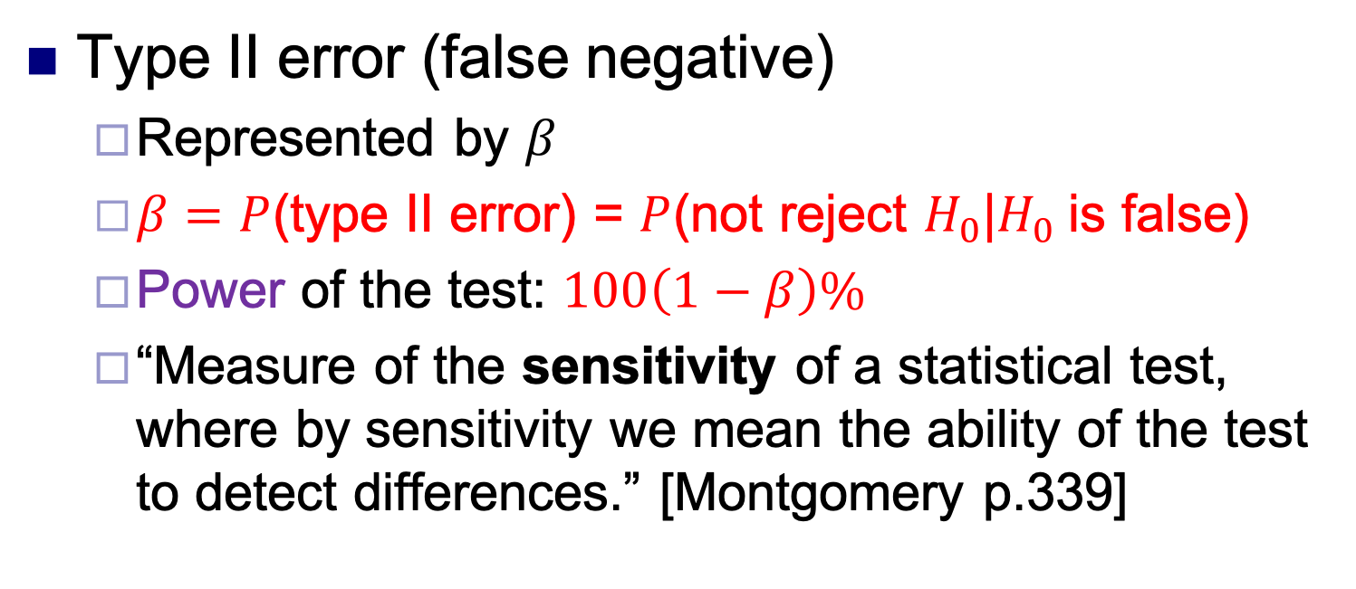
Hypothesis Testing
Type II error (false negative)
Represented by $β$
$β=P$(type II error) = $P$(not reject $H_{0}$|$H_{0}$is false)
Power of the test: $100\left(1−β\right)\%$
“Measure of the sensitivity of a statistical test, where by sensitivity we mean the ability of the test to detect differences.” [Montgomery p.339]

Slide 13
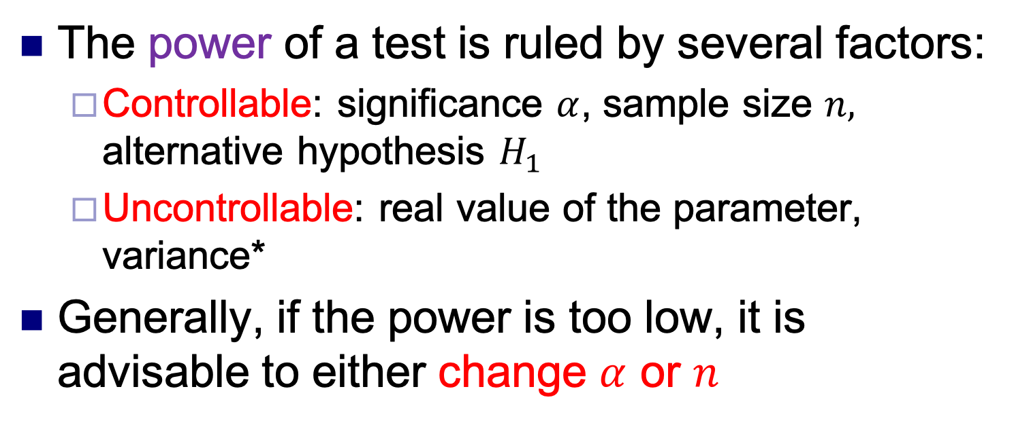
Hypothesis Testing
The power of a test is ruled by several factors:
Controllable: significance $α$, sample size $n,$ alternative hypothesis $H_{1}$
Uncontrollable: real value of the parameter, variance*
Generally, if the power is too low, it is advisable to either change $α$ or $n$

Slide 14
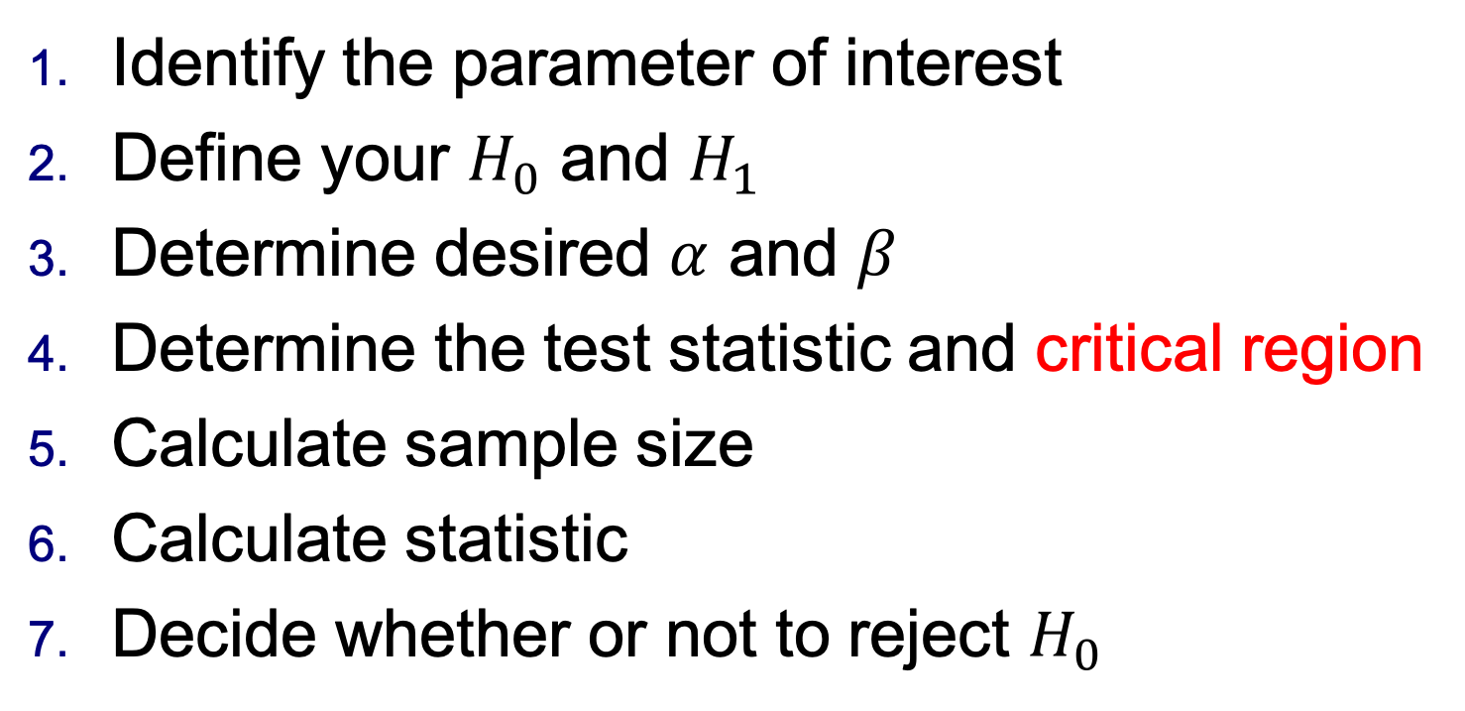
Hypothesis Testing
Identify the parameter of interest
Define your $H_{0}$ and $H_{1}$
Determine desired $α$ and $β$
Determine the test statistic and critical region
Calculate sample size
Calculate statistic
Decide whether or not to reject $H_{0}$

Slide 15
Hypothesis Testing
Test of Hypothesis for one sample
Test of Hypothesis for Two samples

Slide 16
Test of Hypothesis for one sample
Two tests for one sample:
Z-test
Student t-test
Mean of a normal distribution, with variance unknown

Slide 17
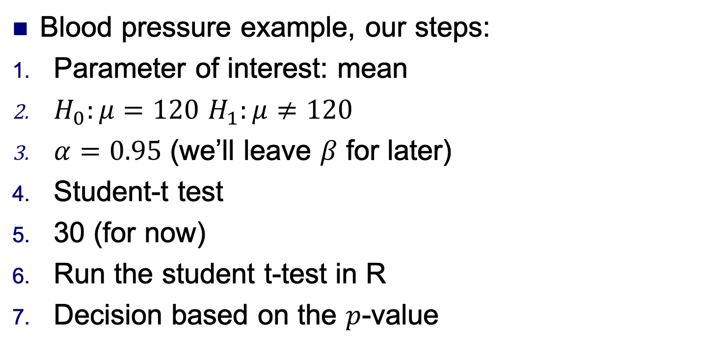
Test of Hypothesis for one sample
Blood pressure example, our steps:
Parameter of interest: mean
$H_{0}:μ=120$ $H_{1}:μ≠120$
$α=0.95$ (we’ll leave $β$ for later)
Student-t test
30 (for now)
Run the student t-test in R
Decision based on the $p$-value

Slide 18
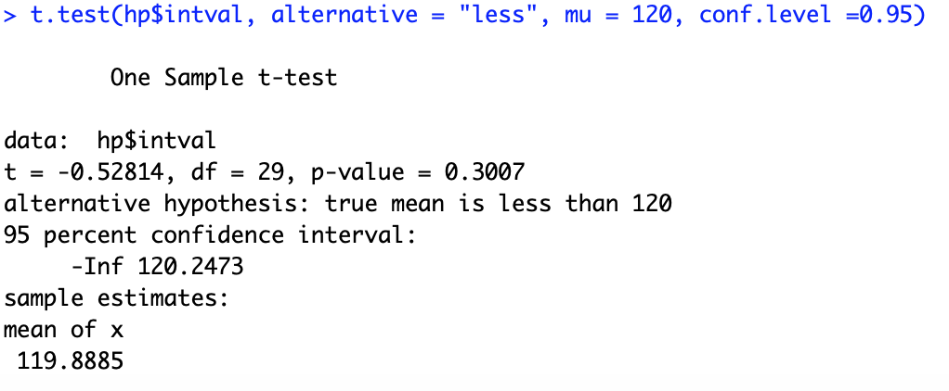
Test of Hypothesis for one sample
Blood pressure example:

Slide 19
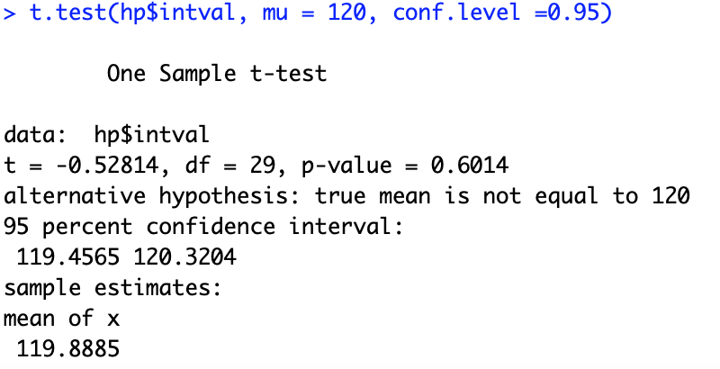
Test of Hypothesis for one sample
Blood pressure example:

Slide 20
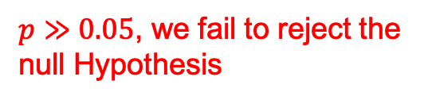
Test of Hypothesis for one sample
Blood pressure example:
$p≫0.05$, we fail to reject the null Hypothesis
What does that mean? The true mean of the population is indeed 120!

Slide 21
Test of Hypothesis for one sample
Blood pressure example one-sided test:

Slide 22
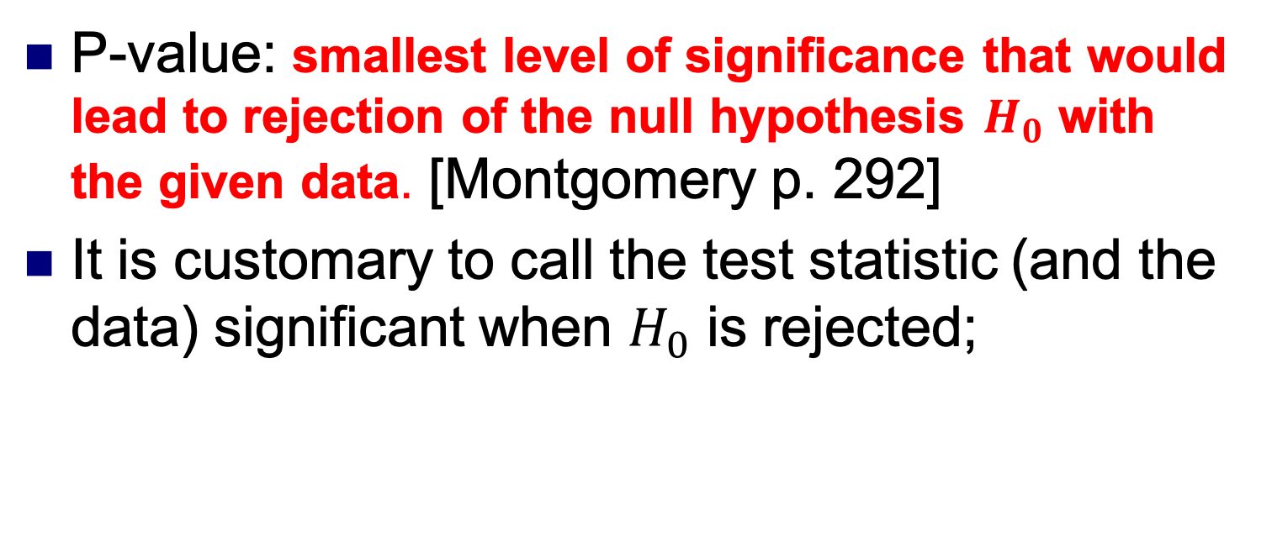
Test of Hypothesis for one sample
P-value: smallest level of significance that would lead to rejection of the null hypothesis $H_{0}$ with the given data. [Montgomery p. 292]
It is customary to call the test statistic (and the data) significant when $H_{0}$ is rejected;

Slide 23
Test of Hypothesis for one sample
Commonly, probability of Type II errors are evaluated a posteriori
Defining the power for avoidance of Type II errors a priori requires care*
Power is a function of 4 elements:
Size of the difference;
Variability of observations;
Significance level;
Sample size;
The experimenter has little to no control
[Campelo chap.5 p.30]

Slide 24
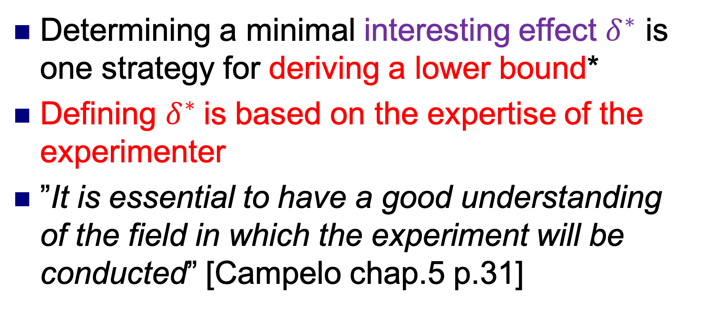
Test of Hypothesis for one sample
Determining a minimal interesting effect $δ^{∗}$ is one strategy for deriving a lower bound*
Defining $δ^{∗}$is based on the expertise of the experimenter
”It is essential to have a good understanding of the field in which the experiment will be conducted” [Campelo chap.5 p.31]

Slide 25
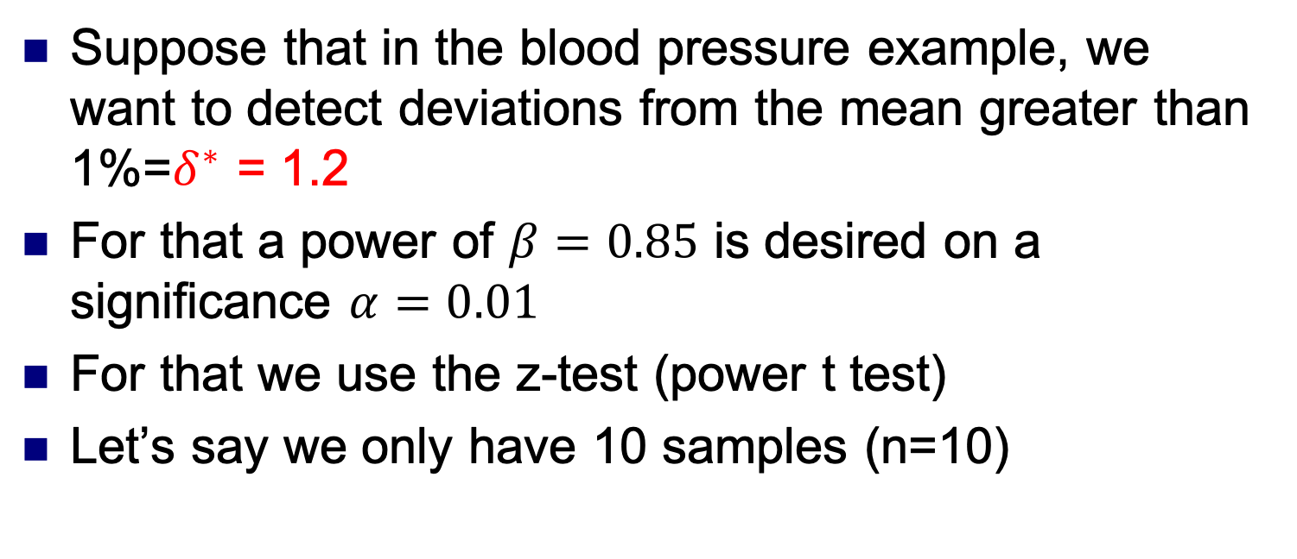
Test of Hypothesis for one sample
Suppose that in the blood pressure example, we want to detect deviations from the mean greater than 1%=$δ^{∗}$ = 1.2
For that a power of $β=0.85$ is desired on a significance $α=0.01$
For that we use the z-test (power t test)
Let’s say we only have 10 samples (n=10)

Slide 26
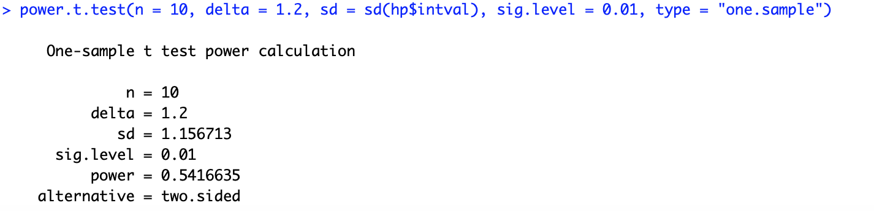
Test of Hypothesis for one sample
For 10 samples, we have a power of 0.54, for what sample size can we have a power of 0.85?

Slide 27
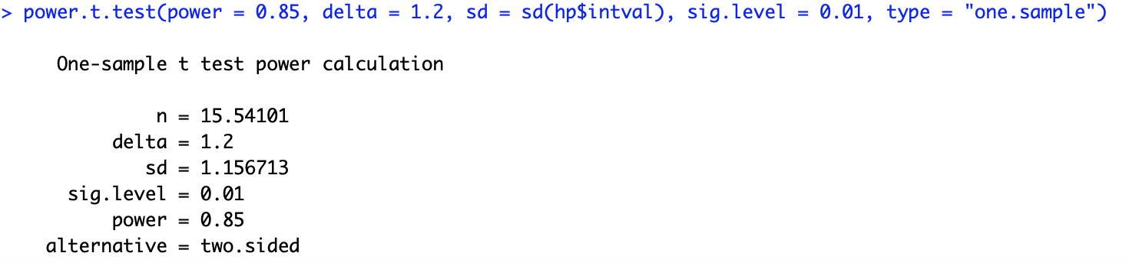
Test of Hypothesis for one sample
Round this value up!
We need 16 samples to achieve a power of 0.85!

Slide 28
Test of Hypothesis for one sample
Validation of our model is required!
Tests to be performed on data:
Normality
Independence

Slide 29
Test of Hypothesis for one sample
Normality: does it follow a normal distribution?
QQ-plot

Slide 30
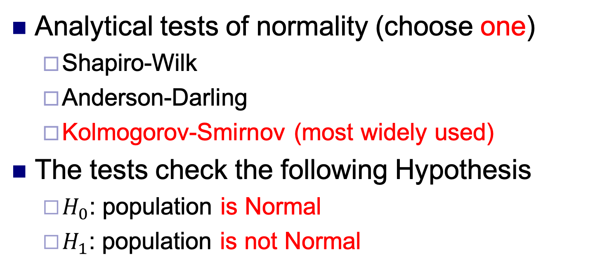
Test of Hypothesis for one sample
Analytical tests of normality (choose one)
Shapiro-Wilk
Anderson-Darling
Kolmogorov-Smirnov (most widely used)
The tests check the following Hypothesis
$H_{0}$: population is Normal
$H_{1}$: population is not Normal

Slide 31
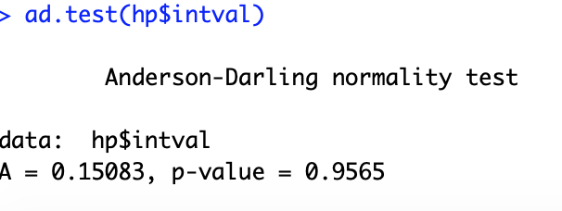
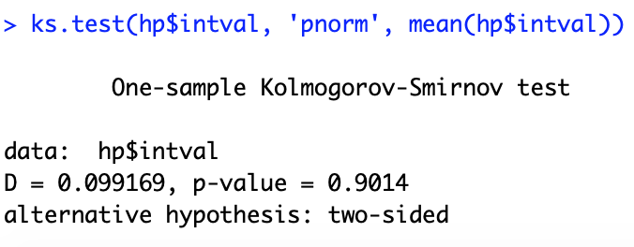
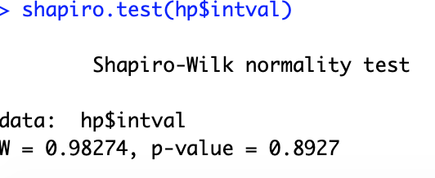
Test of Hypothesis for one sample

Slide 32
Test of Hypothesis for one sample
What if my data is not normal?
We can either:
”Punch” the data until it becomes normal
Use non-parametric tests

Slide 33
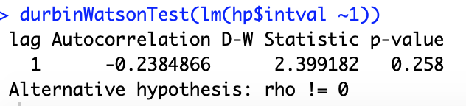
Test of Hypothesis for one sample
Independence of data:
Test for absence of unmodeled biases contaminating the data*
Sensitive upon ordering of data
Assumption not too reliable
Durbin-Watson test

Slide 34
Hypothesis Testing
Test of Hypothesis for one sample
Test of Hypothesis for Two samples

Slide 35
Test of Hypothesis for two samples
Comparison between two samples follow the same rationale behind testing for one sample
Usually we compare:
Means
Variances
Etc…

Slide 36
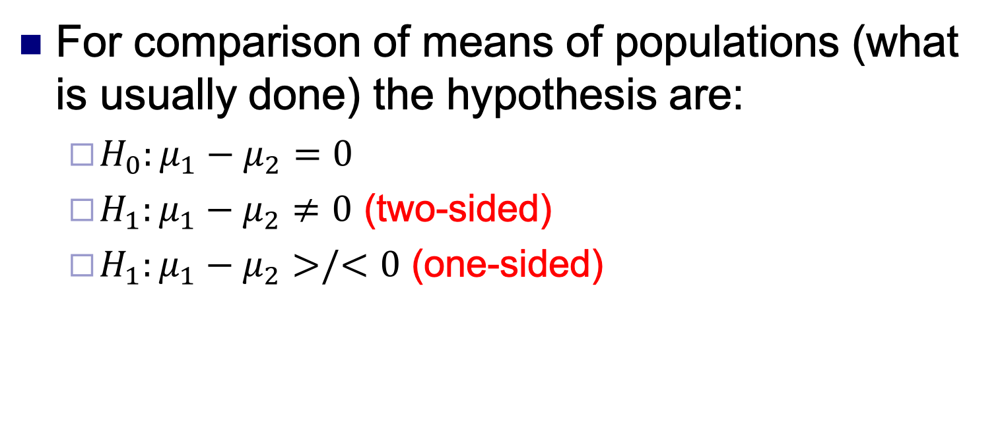
Test of Hypothesis for two samples
For comparison of means of populations (what is usually done) the hypothesis are:
$H_{0}:μ_{1}−μ_{2}=0$
$H_{1}:μ_{1}−μ_{2}≠0$ (two-sided)
$H_{1}:μ_{1}−μ_{2}>/<0$ (one-sided)

Slide 37
Test of Hypothesis for two samples
Usually two kinds of tests are performed:
Two-sample t-test
Paired t-test
Obviously, we assume normality of data

Slide 38
Test of Hypothesis for two samples
Example: a new medicine has been tested for patients for high blood pressure. We have two groups: control and test
Control has normal systolic pressure
Is the parameters of the distribution of the test group similar to the control?
N = 30
Load the Hpressure_multiple.csv dataset

Slide 39
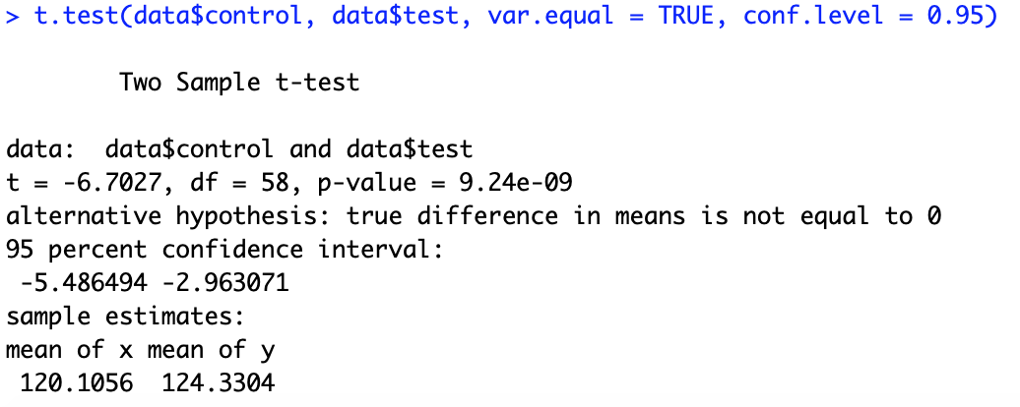
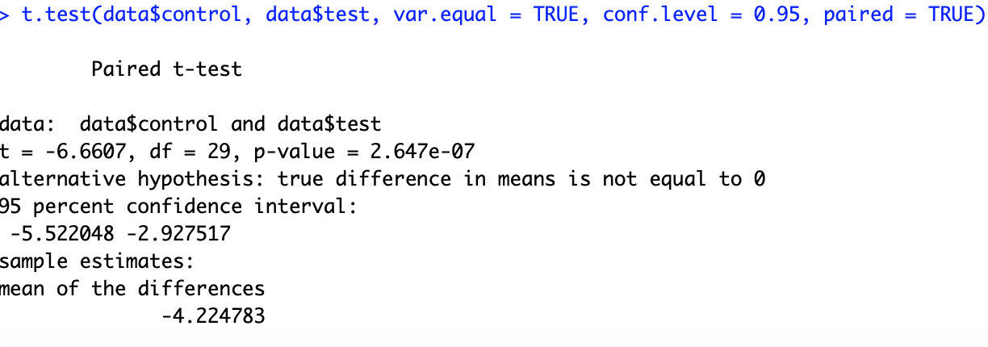
Test of Hypothesis for two samples

Slide 40
Test of Hypothesis for two samples
Paired t-test: we assume that the samples are measure pairwise
Should we pair or not?
If there is a small variance, and the correlation between pairs is small, the independent-sample is favored
If the variance is high and there is a large positive correlation within pairs, the paired experiment should be used

Slide 41
Test of Hypothesis for two samples
Validation of the model is also done
Tests to be performed on data:
Normality
Heteroscedascity
Independence

Slide 42
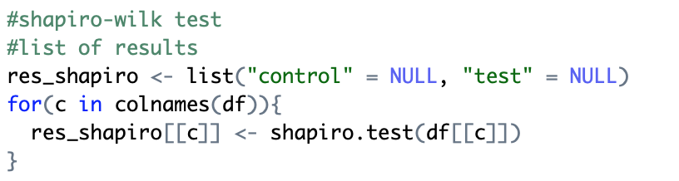
Test of Hypothesis for two samples
Normality: QQ-plot and Shapiro-Wilk
In this case, if normality fails, we’re better off with non-parametric tests!

Slide 43
Test of Hypothesis for two samples
Normality: QQ-plot and Shapiro-Wilk
In this case, if normality fails, we’re better off with non-parametric tests!

Slide 44
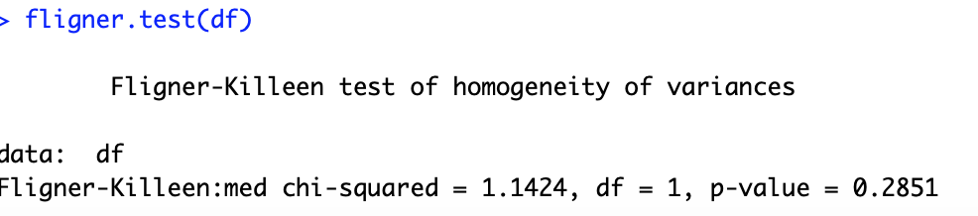
Test of Hypothesis for two samples
Heteroscedascity: if the data has low or high variance
Fligner-Kileen test

Slide 45
Test of Hypothesis for two samples
Heteroscedascity: plot of the residuals

Slide 46
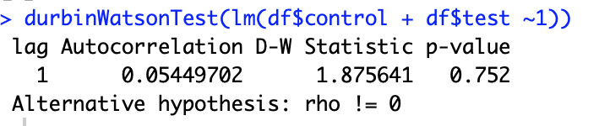
Test of Hypothesis for two samples
Independence: Durbin-Watson test
Check the autocorrelation in the residuals between each data point.
Also not reliable because it is sensitive to the ordering of data

Slide 47
Next Episode
Non-parametric tests
Iman-Davenport
Dunn Test
Holm Test
Hochberg Test
One and two-way ANOVA
Linear Regression
Logistic Regression
Time-series Data (maybe?)

Slide 48
Hypothesis Testing
Marco Antonio Florenzano Mollinetti¹
¹University of Tsukuba, Systems Optimization Laboratory
mollinetti@syou.cs.tsukuba.ac.jp

